Slide 1
Computer Graphics HW 3: Robot Arm
Deadline: 2023.05.02 (before class)

Slide 2
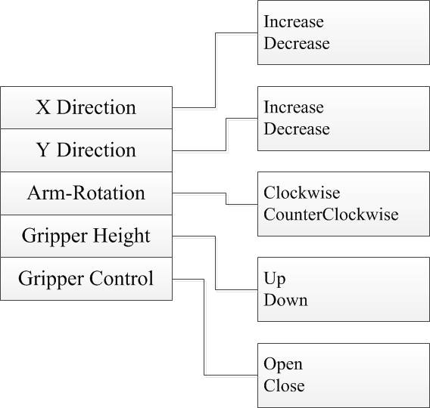
Requirement
Description
Draw the robot initially standing on the floor y=0;
The user can control the robot which has five degree of freedom (DOFs)
The control of robot is through the Menu user interface

Slide 3
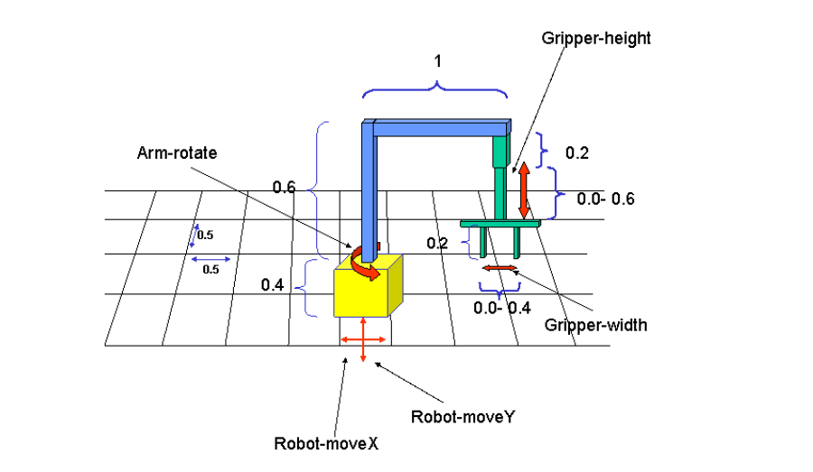
Robot Configuration

Slide 4
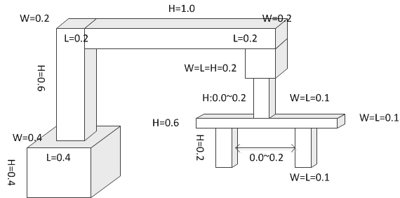
Robot Configuration

Slide 5
